Slide 1
Portable And Lightweight Oscilloscope
Group 6: Andrew Gondoputro, Luka Radovic, Gavin Le

Slide 2
Project Summary
Designed a portable, dual-channel digital oscilloscope
Supports ±10 V analog inputs and 200 kHz sampling per channel
Built around a Teensy 4.1 with a fully custom analog front end (AFE)
Real-time signal display on onboard LCD (no PC required)
Single rotary encoder/button used for all user interaction (pause, trigger, scale)
Main goals: Low-cost, portable, standalone oscilloscope for student/lab use
Challenges included:
Conditioning ±10 V signals to 0–3.3 V ADC range
Achieving stable ADC performance
Integrating all blocks into a clean enclosure
Achievements: Verified performance, clean interface

Slide 3
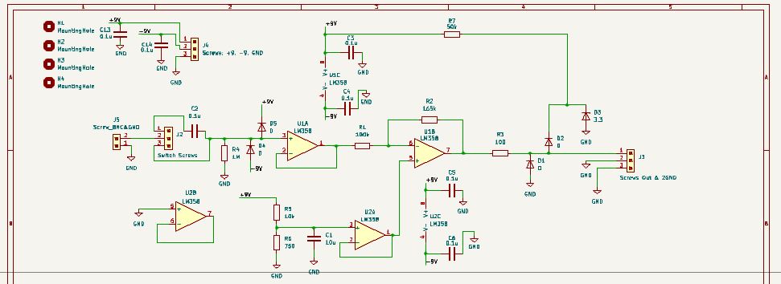
Analog Front End

Slide 4
Power Block/Supply and User Interface/Display
Gavin Le

Slide 5
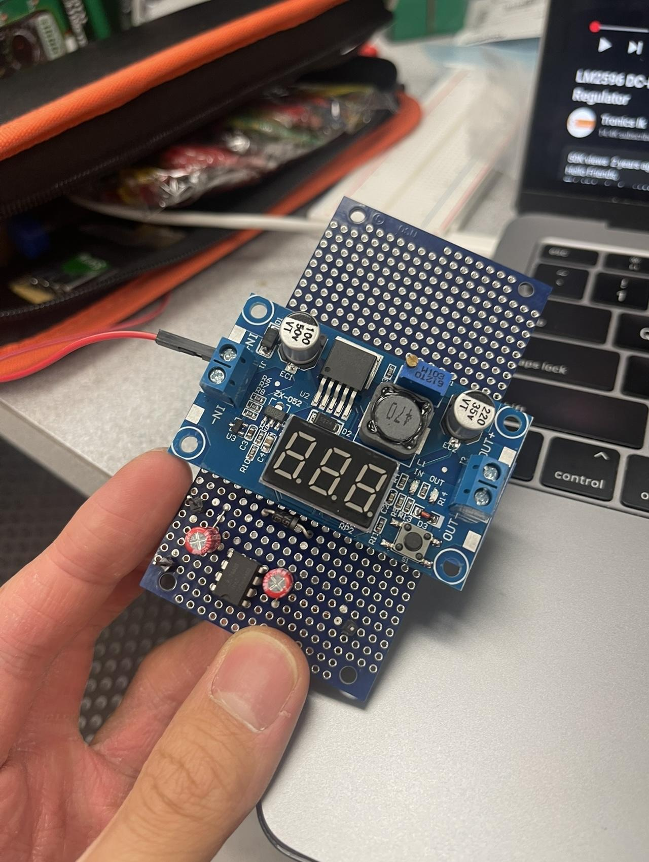
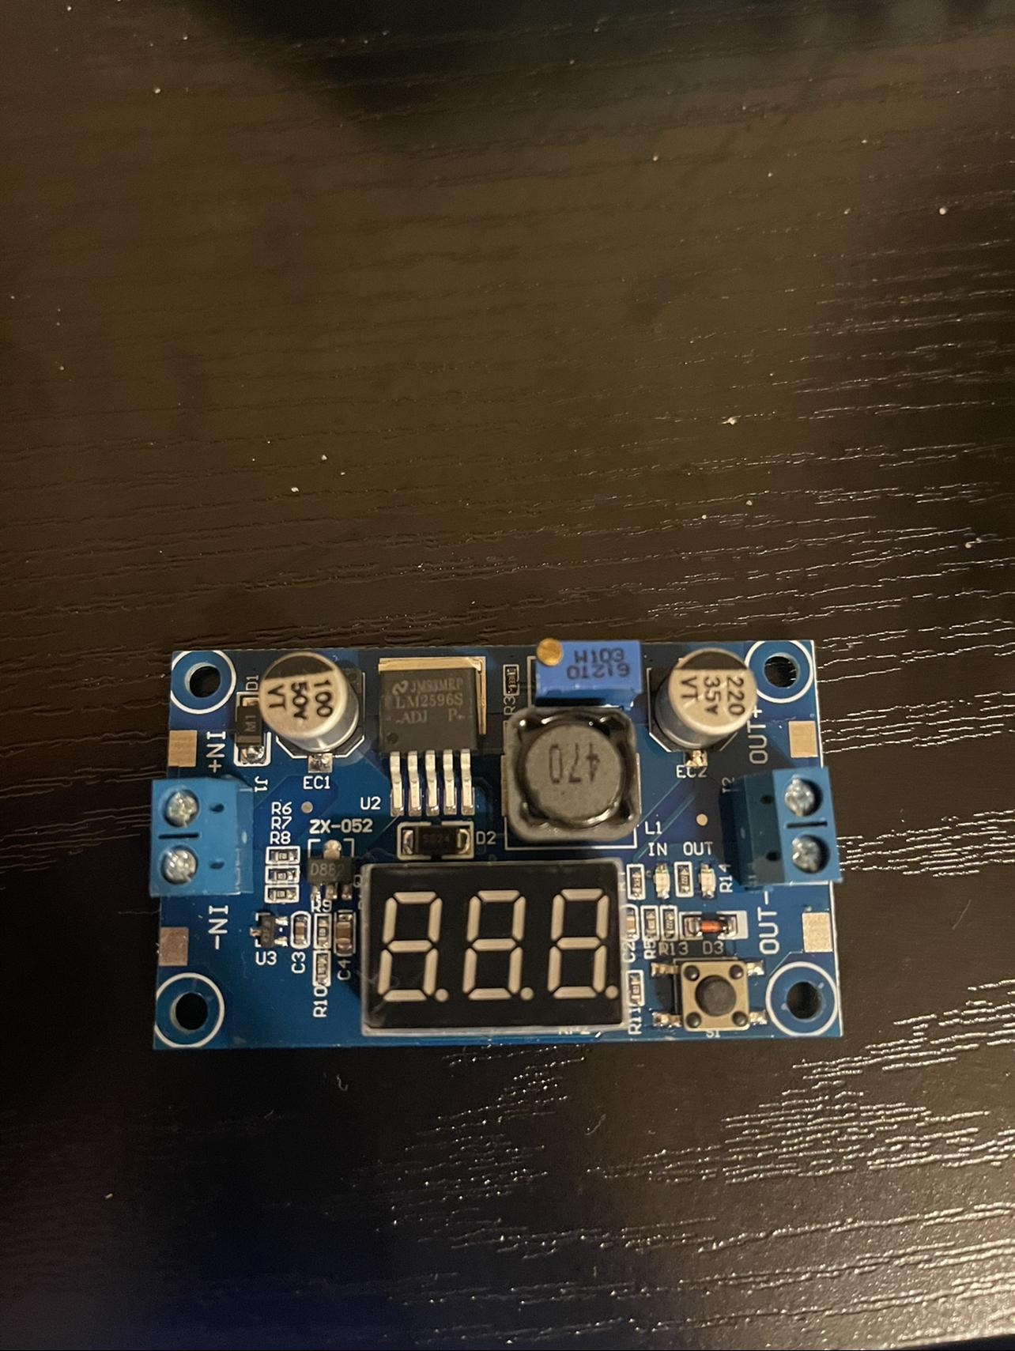
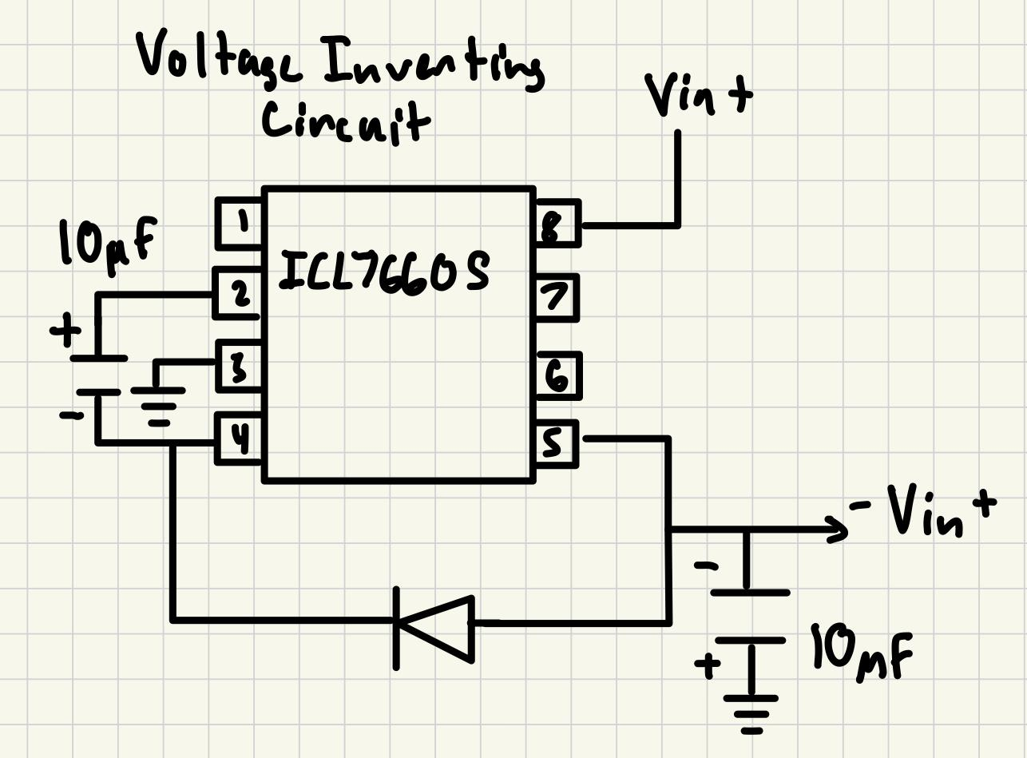
Power Block/Supply
Step down/convert voltages for the other oscilloscope components
Eplzon 2596 Buck Converter and Voltage Inverter Circuit
Each separate block supplies different voltages to different components of the oscilloscope
Notes:
The purpose of the power block is to step down and convert the input voltage of 9V into the voltages needed for each of the components for the oscilloscope. The power block is made up of three separate blocks. These blocks are the Eplzon 2596 Buck Converter, a voltage inverter circuit, and a linear voltage regulator. Each of these separate blocks serve their own purpose for the oscilloscope. The Elpzon 2596 Buck Converter steps down the voltage from 9V to 5V for the input voltage for the Teensy 4.1 microcontroller and the Hosyond LCD screen. The Voltage Inverter Circuit will invert the 9V input voltage to -9V, and both of these voltages will be for the ADC signal interpreter. The linear voltage regulator takes 5V from the buck converter and steps it down to 3.3V, which is then outputted to the encoder.

Slide 6
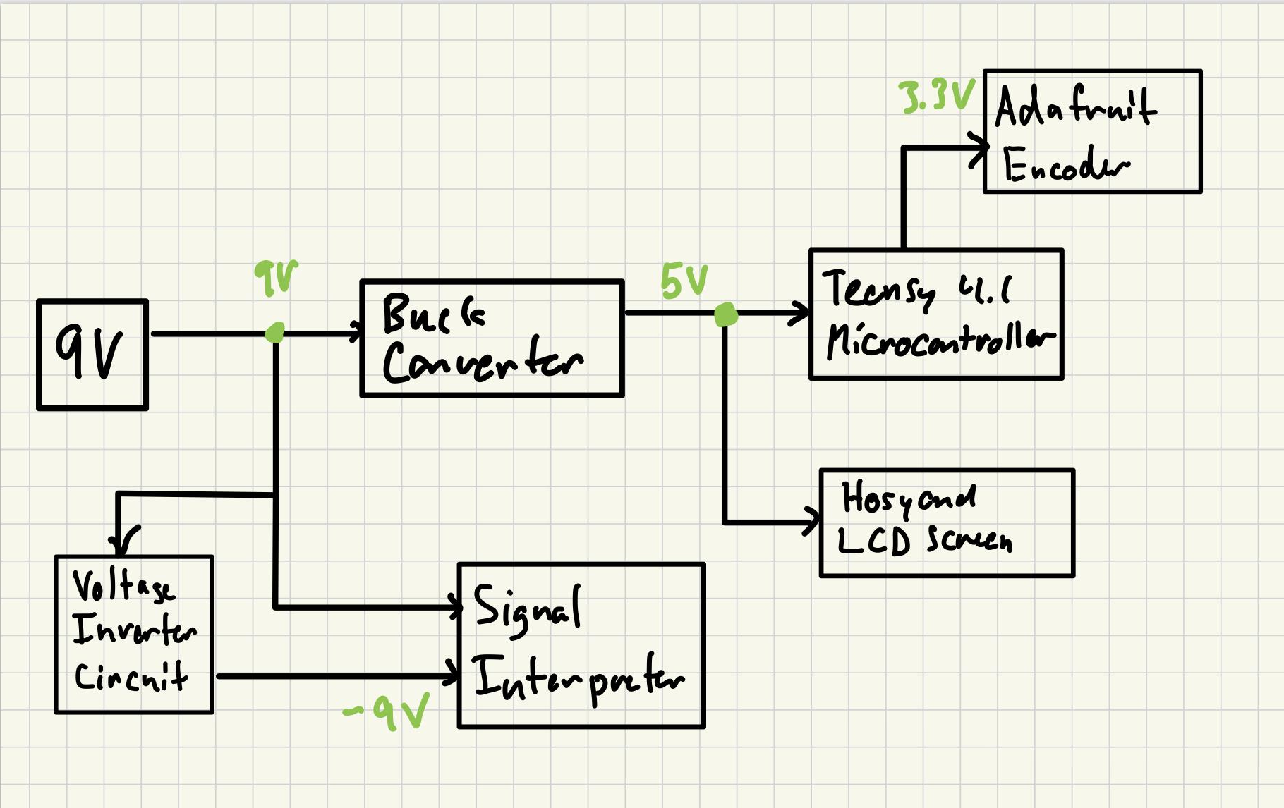
Diagram
Notes:
The flowchart below helps to visualize how each separate block works, as well as their input and output voltages. Each of these separate blocks serve their own purpose for the oscilloscope. The Elpzon 2596 Buck Converter steps down the voltage from 9V to 5V for the input voltage for the Teensy 4.1 microcontroller and the Hosyond LCD screen. The Voltage Inverter Circuit will invert the 9V input voltage to -9V, and both of these voltages will be for the ADC signal interpreter. The linear voltage regulator takes 5V from the buck converter and steps it down to 3.3V, which is then outputted to the encoder.

Slide 7
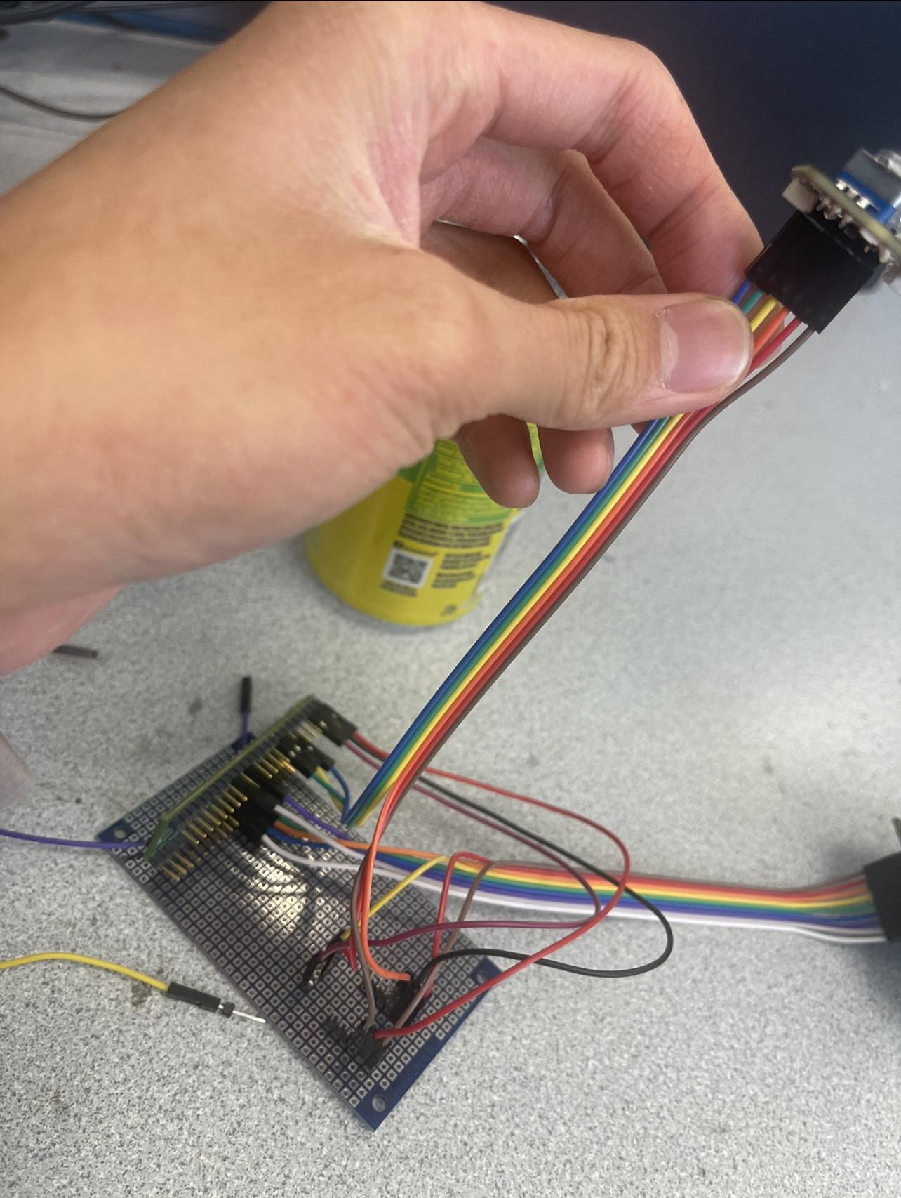
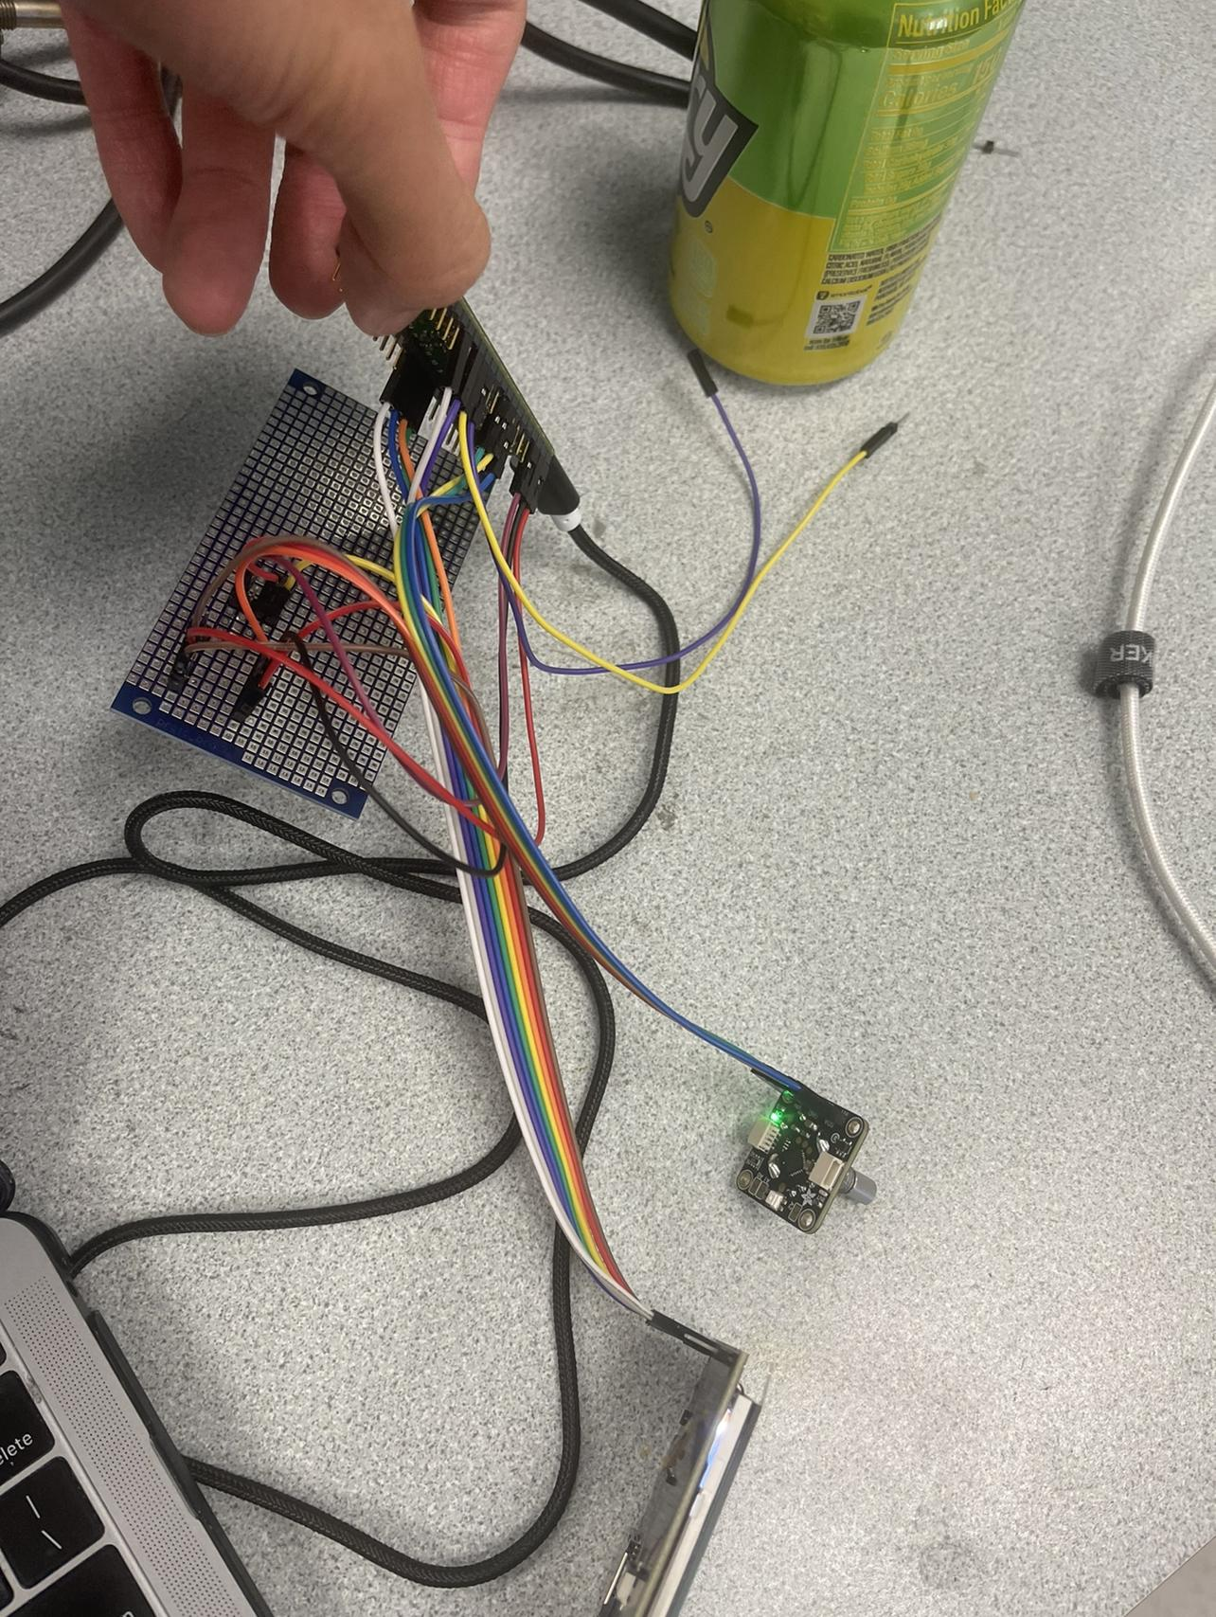
User Interface/Display
One Adafruit I2C Stemma QT Rotary Encoder
Acts as button and knob
Allows for switching between channels, axes, selecting/triggering, and sweeping signals
Hosyond IPS Capacitive Touch Screen LCD Module
Displays time and voltage axes, as well as electric signal
Teensy 4.1 Microcontroller
Handles the code and functions of the oscilloscope
Acts as an interface bridge between the encoder and lcd screen
Notes:
The user interface and display is made up of three components. One adafruit I2C Stemma QT Rotary Encoder, the Hosyond IPS Capacitive Touch Screen LCD Module, and the Teensy 4.1 Microcontroller. For our oscilloscope, we decided to use only one rotary encoder to to act as a button and knob for the oscilloscope. This simplifies the user interface so there are less buttons and knobs to work with when designing our oscilloscope. This rotary encoder allows for the user to select between different channels, axis’, trigger the oscilloscope, or sweep through signals. The Teensy 4.1 microcontroller acts as an interface bridge between both the encoder and the lcd screen, since they both use different interfaces, the encoder using I2C, and the lcd screen using spi.

Slide 8
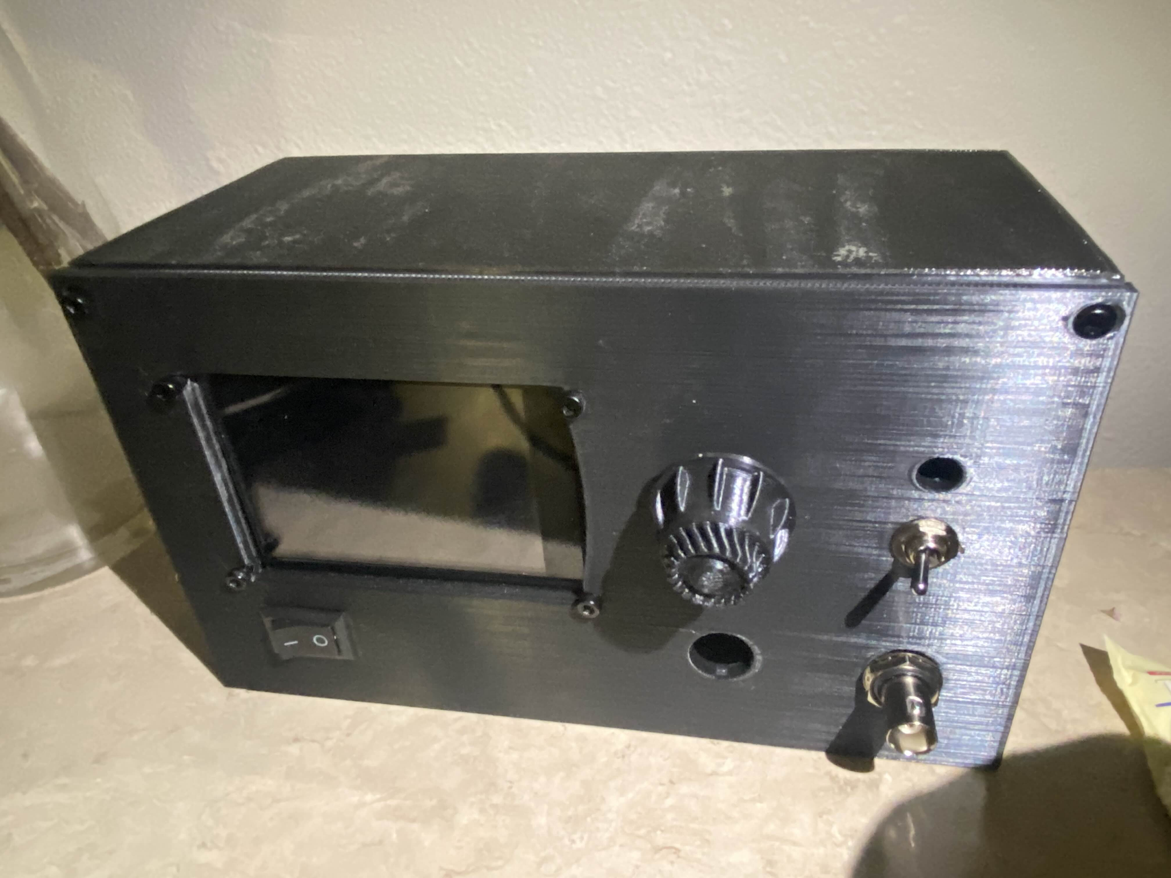
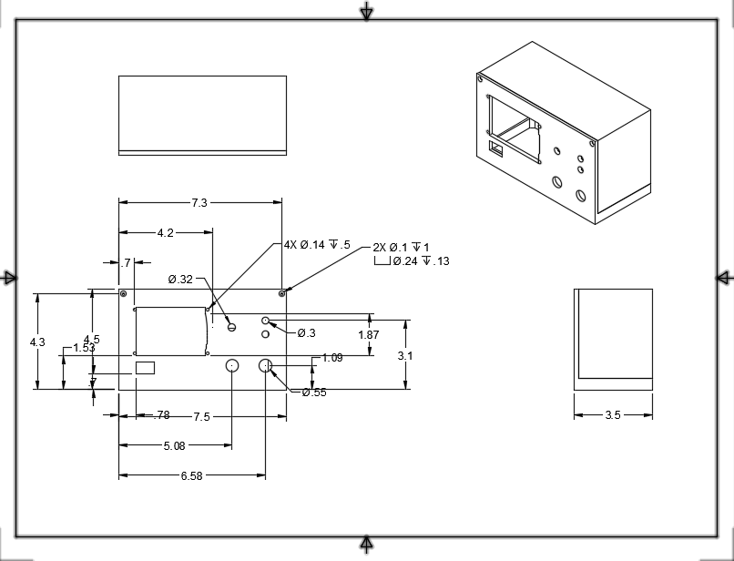
Enclosure
Made in CAD for exact measurements -> 3D Printed in PLA Plastic
Sizing of: 3.5 x 4.5 x 7.5in
Slots for each UI component to fit properly either through tolerances or screws
Interior holding all other blocks with proper placement

Slide 9
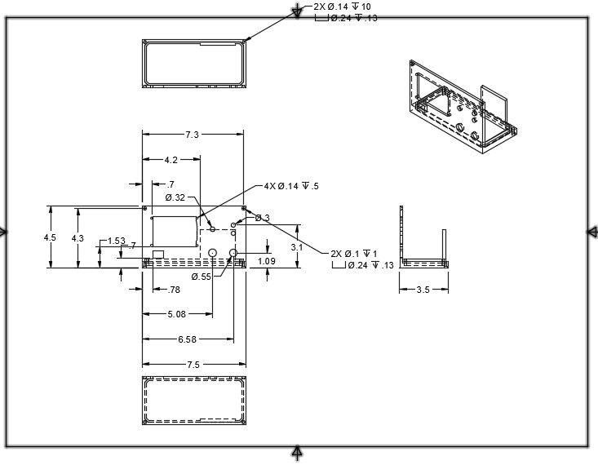
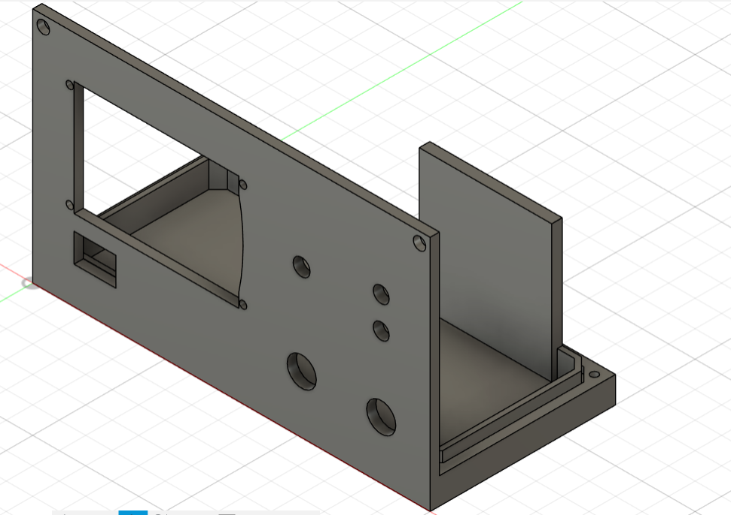
Bottom Piece

Slide 10
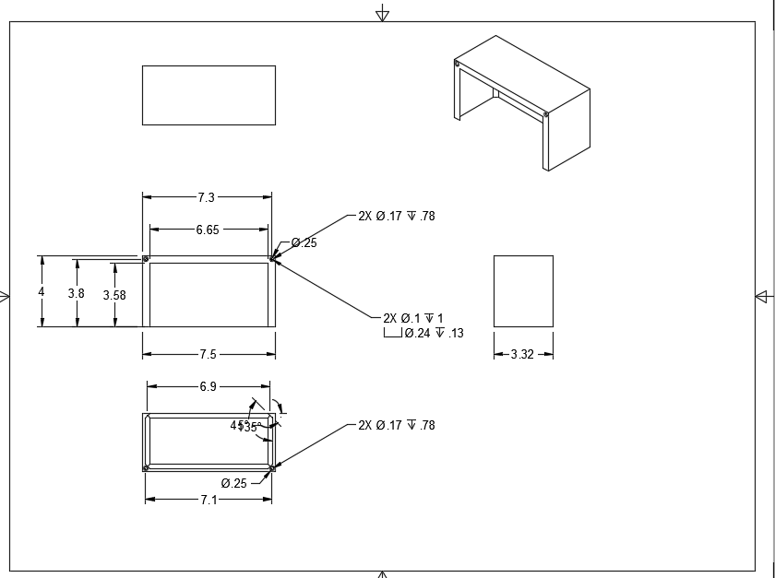
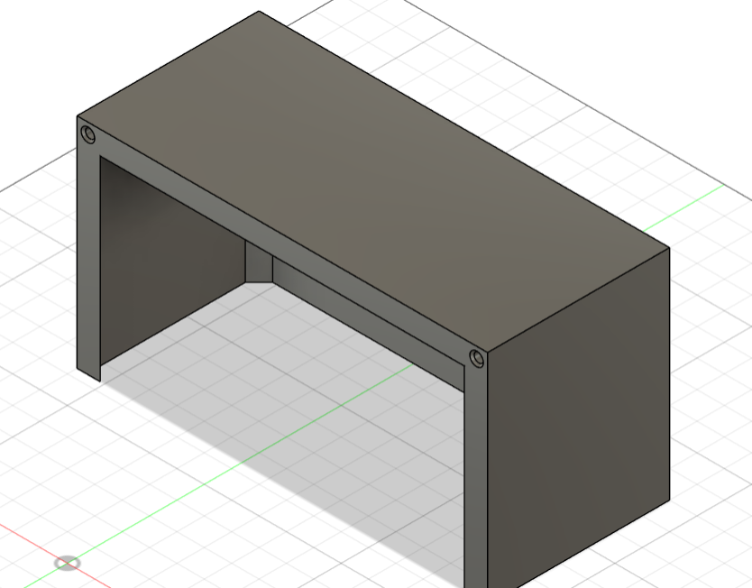
Top Piece

Slide 11
Code
Main Parts:
Receiving signals from ADC to sample a high frequency
Receiving User Input from encoder
Coding a User Output on the LCD

Slide 12
Code Flowchart
ADC loop
UI Code
Register if Encoder moves
Setup
Sample from ADC
Updates Value on Encoder
Map it to original value
Turns array of values into points of LCD
No
Yes
Store in Array of samples
Writes text and Displays values on LNCD
Array full?

Slide 13
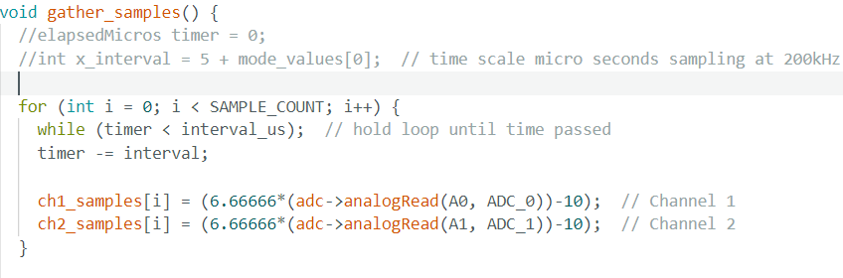
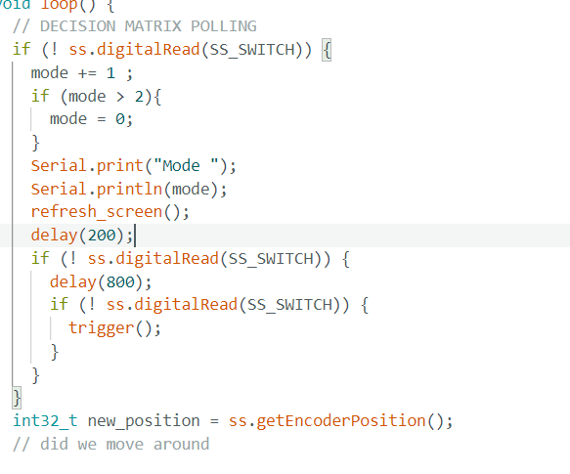
Code: Sampling

Slide 14
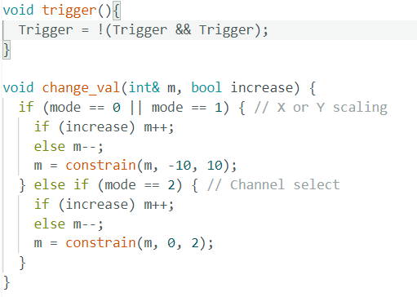
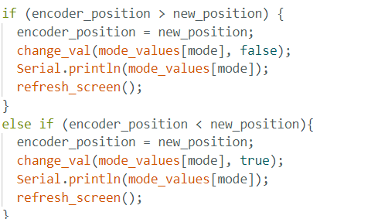
Code: User Input

Slide 15
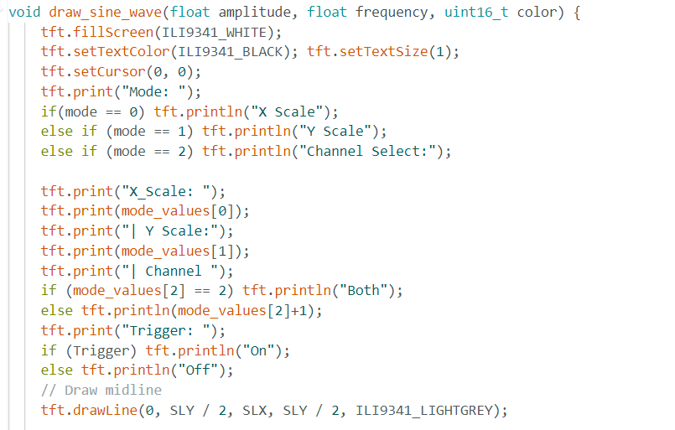
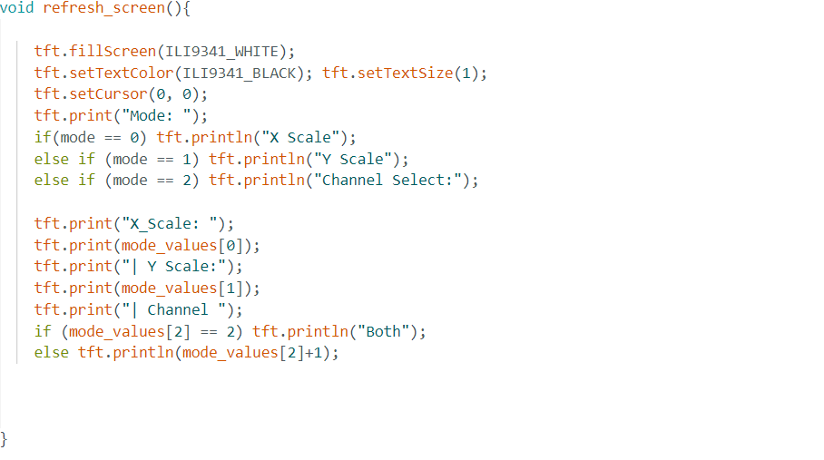
Code: User Output

Slide 16
Closing
Achieved:
Safe ±10 V input range
200 kHz sampling per channel
Real-time LCD display with intuitive control
Fully modular and battery-powered design
Built completely from scratch with protoboards, firmware, and 3D printing
Future improvements:
Custom PCB for better layout and durability
Higher-resolution display or waveform features (e.g., FFT mode)
Expansion to 4+ channels or wireless display integration
Demonstrated that lab-grade tools can be made compact, affordable, and user-friendly

